Slide 1
Learning Spark Streaming
Dingtinghe
dingth@chinatelecom.cn

Slide 2
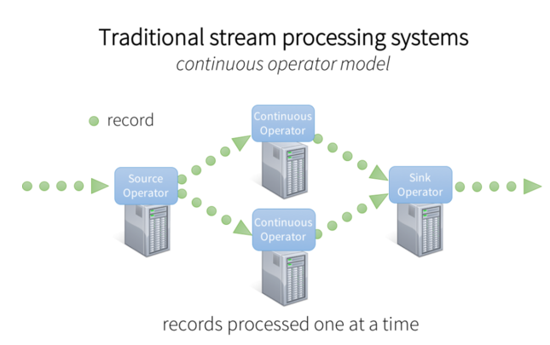
Notes:
连续算子
故障迅速恢复
负载均衡
统一的流处理与批处理以及交互工作
高级分析

Slide 3
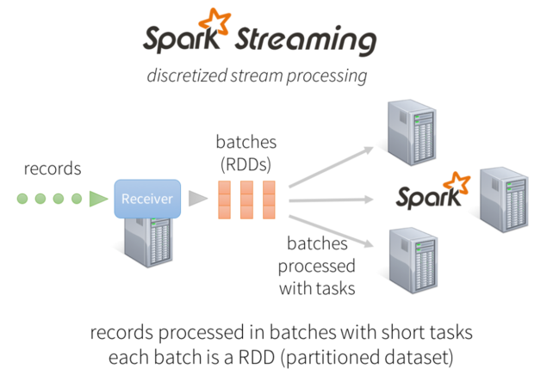
Notes:
Backpressure
Dynamic scaling
Yarn集群

Slide 4
Overview
An extension of the core Spark API that enables scalable, high-throughput, fault-tolerant stream processing of live data streams.
Can apply Spark’s machine learning and graph processing algorithms on data streams.
Can be processed using complex algorithms expressed with high-level functions like map, reduce, join and window.

Slide 5
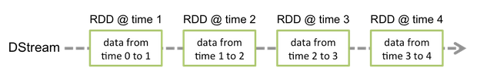
DStream
A high-level abstraction called discretized stream, which represents a continuous stream of data.
DStreams be created either from input data streams from sources such as Kafka, Flume, and Kinesis, or by applying high-level operations on other DStreams.
A DStream is represented by a continuous series of RDDs, each RDD in a DStream contains data from a certain interval

Slide 6
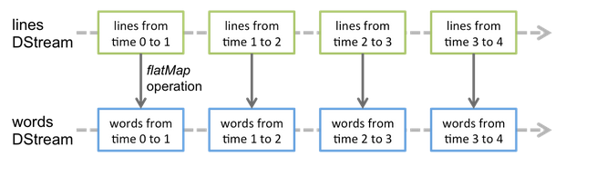
Any operation applied on a DStream translates to operations on the underlying RDDs.

Slide 7
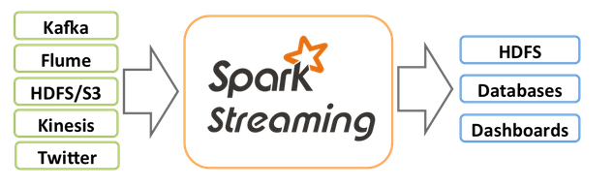
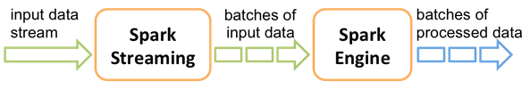
Data Processing
Data Source And Storage
Calculation Flow

Slide 8
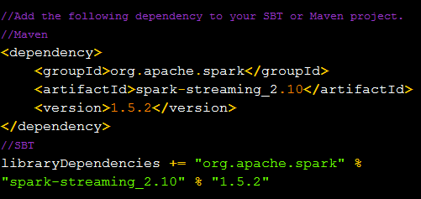
Data Source
Basic Sources
Advanced Sources
Sources directly available in the StreamingContext API.
Examples: file systems, socket connections, and Akka actors
Be available through maven central and should add the corresponding artifact
Sources like Kafka, Flume, Kinesis, Twitter, zeroMQ,MQTT
The number of cores must be more than the number of receivers.

Slide 9
Procedure
Define a context.
Define the input sources by creating input DStreams.
Define the streaming computations by applying transformation and
output operations to DStreams.
Start receiving data and processing it using streamingContext.start().
Wait for the processing to be stopped (manually or due to any error)
using streamingContext.awaitTermination().
The processing can be manually stopped using streamingContext.stop().

Slide 10
Starting Point: StreamingContext
StreamingContext is the main entry point for all streaming functionality.
Once a context has been started, no new streaming computations can be set up or added to it.
Once a context has been stopped, it cannot be restarted.
Only one StreamingContext can be active in a JVM at the same time.
stop() on StreamingContext also stops the SparkContext. To stop only the StreamingContext, set the optional parameter of stop() called stopSparkContext to false.
A SparkContext can be re-used to create multiple StreamingContexts, as long as the previous StreamingContext is stopped (without stopping the SparkContext) before the next StreamingContext is created.

Slide 11
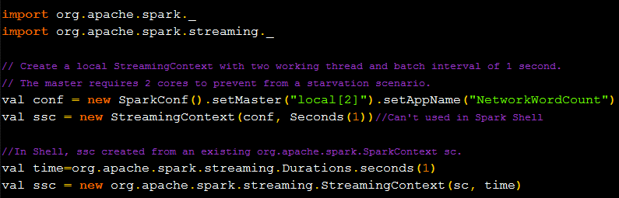

Slide 12
Input DStreams and Receivers
Basic Sources
File Streams : any file system compatible with HDFS API (HDFS, S3, NFS, etc.)
Streams based on Custom Actors: received through Akka actors
Queue of RDDs as a Stream : Each RDD will be treated as a batch of data

Slide 13

Advanced Sources
Create a DStream using data from Twitter’s stream of tweets:
Linking: Add the artifact to the SBT/Maven project dependencies.
Programming: Import the TwitterUtils class and create a DStream with TwitterUtils.createStream.
Deploying: Generate an uber JAR with all the dependencies (including the dependency spark-streaming-twitter_2.10 and its transitive dependencies) and then deploy the application.

Slide 14
Transformations on DStreams
DStreams support many of the transformations available on normal Spark RDD’s
map | flatMap | filter
union | count | reduce
countByValue | reduceByKey | join
transform | updateStateByKey | cogroup
Notes:
与RDD的是不同的

Slide 15
UpdateStateByKey Operation
Maintain arbitrary state while continuously updating it with each Discretized Streams
Operator step:
Define the state - The state can be an arbitrary data type.
Configur the checkpoint directory
Define the state update function - Specify with a function how to update the state using the previous state and the new values from an input stream.

Slide 16
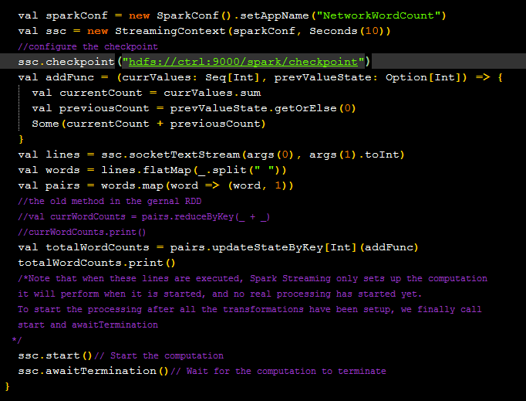
Notes:
上另外一个例子

Slide 17
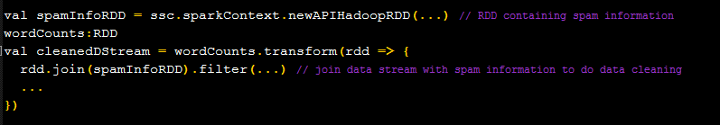
Transform Operation
Allows arbitrary RDD-to-RDD functions to be applied on a DStreamOperator
The supplied function gets called in every batch interval.
Fit to do time-varying RDD operations, that is, RDD operations, number of partitions, broadcast variables, etc. can be changed between batches

Slide 18
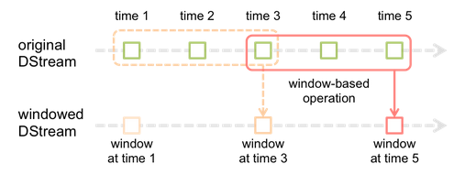
Window Operations
As shown in the figure, every time the window slides over a source DStream, the source RDDs that fall within the window are combined and operated upon to produce the RDDs of the windowed DStream.
Parameters
window length - The duration of the window (3 in the figure).
sliding interval - The interval at which the window operation is performed (2 in the figure).

Slide 19
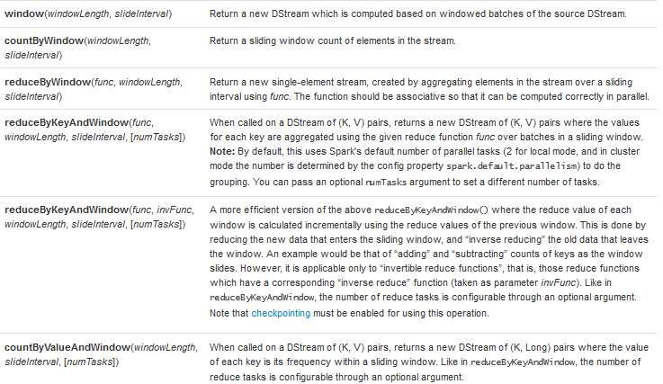
Some of the common window operations

Slide 20



Join Operations
Stream-stream joins
Joins over windows of the streams
Stream-dataset joins

Slide 21
Output Operations on DStreams
Transformation | Meaning
print() | Prints the first ten elements of every batch of data in a DStream on the driver node running the streaming application.
saveAsTextFiles(prefix, [suffix]) | Save this DStream's contents as text files
saveAsObjectFiles(prefix, [suffix]) | Save this DStream's contents as SequenceFiles of serialized Java objects.
saveAsHadoopFiles(prefix, [suffix]) | Save this DStream's contents as Hadoop files.
foreachRDD(func) | This function should push the data in each RDD to an external system

Slide 22
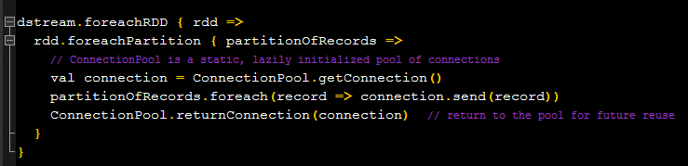
Design Patterns for using foreachRDD
The most efficient sending of data to external systems.
foreachRDD : output operation in driver
transform : transform in receivers, should return same type

Slide 23
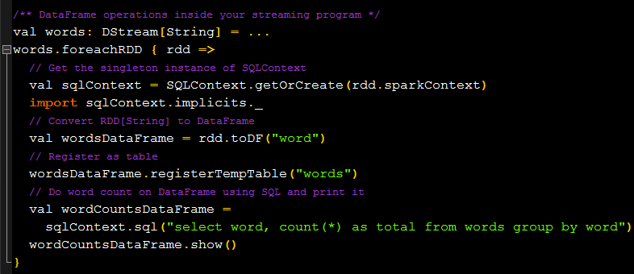
DataFrame and SQL Operations
Have to create a SQLContext using the SparkContext that the StreamingContext is using, such that it can be restarted on driver failures.

Slide 24
MLlib Operations
First of all, there are streaming machine learning algorithms
Beyond these, for a much larger class of machine learning algorithms, can learn a learning model offline and then apply the model online on streaming data.

Slide 25
Caching / Persistence
Using the persist() method on a DStream will automatically persist every RDD
of that DStream in memory
For input streams that receive data over the network ,the default persistence
level is set to replicate the data to two nodes for fault-tolerance.
DStreams generated by window-based operations are automatically persisted
in memory, without the developer calling persist().
Unlike RDDs, the default persistence level of DStreams keeps the data
serialized in memory.

Slide 26
Checkpointing
Spark Streaming needs to checkpoint enough information to a fault- tolerant storage system such that it can recover from failures.
Metadata checkpointing: primarily for recovery from driver failures
Configuration - The configuration that was used to create the streaming application.
DStream operations - The set of DStream operations that define the streaming application.
Incomplete batches - Batches whose jobs are queued but have not completed yet.
When: Recovering from failures of the driver running the application
Data checkpointing: for basic functioning if stateful transformations are used.
Saving of the generated RDDs in some stateful transformations that combine data across multiple batches to cut off the dependency chains.
When: Usage of stateful transformations - updateStateByKey or reduceByKeyAndWindow

Slide 27
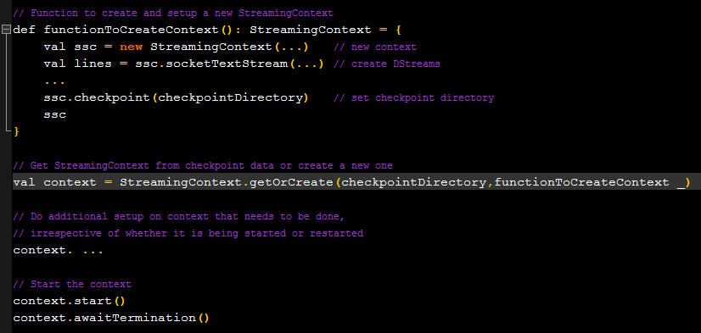
How to configure Checkpointing

Slide 28
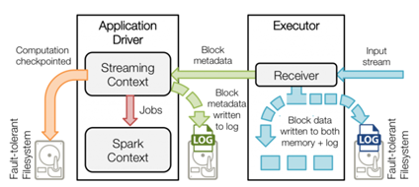

Slide 29
Deploying Applications
Cluster with a cluster manager
Package the application JAR
Configuring sufficient memory for the executors
Configuring checkpointing
Configuring automatic restart of the application driver
Configuring write ahead logs
Data received from a receiver gets written into a write ahead log, but increase cost of the receiving throughput
Setting spark.streaming.receiver.writeAheadLog.enable to true.
Setting the storage level for the input stream to StorageLevel.MEMORY_AND_DISK_SER.
Setting the max receiving rate
Setting spark.streaming.receiver.maxRate or spark.streaming.backpressure.enabled to true.

Slide 30
Performance Tuning
Reducing the Batch Processing Times
Setting the Right Batch Interval

Slide 31
Reducing the Batch Processing Times
Level of Parallelism in Data Receiving
Creating multiple input DStreams to receive different partitions of the data stream from the source
Reduce the block interval to increase the number of tasks for a given batch interval
Explicitly repartition the input data stream
Level of Parallelism in Data Processing
Change the default number of parallel tasks
Data Serialization
Input data
Persisted RDDs generated by Streaming Operations
Task Launching Overheads
Task Serialization

Slide 32
Setting the Right Batch Interval
Test it with a conservative batch interval (say, 5-10 seconds) and a low data rate.
Check the value of the end-to-end delay experienced by each processed batch.
Adjust configuration.

Slide 33
Memory Tuning
Amount of cluster memory depends on the type of transformations used
See the memory usage on a small scale and estimate accordingly.
Garbage collection
Persistence Level of Dstreams : Data Serialization
Clearing old data
Garbage Collector : both on driver and executors
Use more executors with smaller heap sizes
Use Tachyon

